Slide 1

Redbus data scraping with selenium & dynamic filtering using streamlit

Slide 2

AGENDA
Problem statement
Understanding and process map
Data scraping using selenium
SQL database
Streamlit design
conclusion

Slide 3
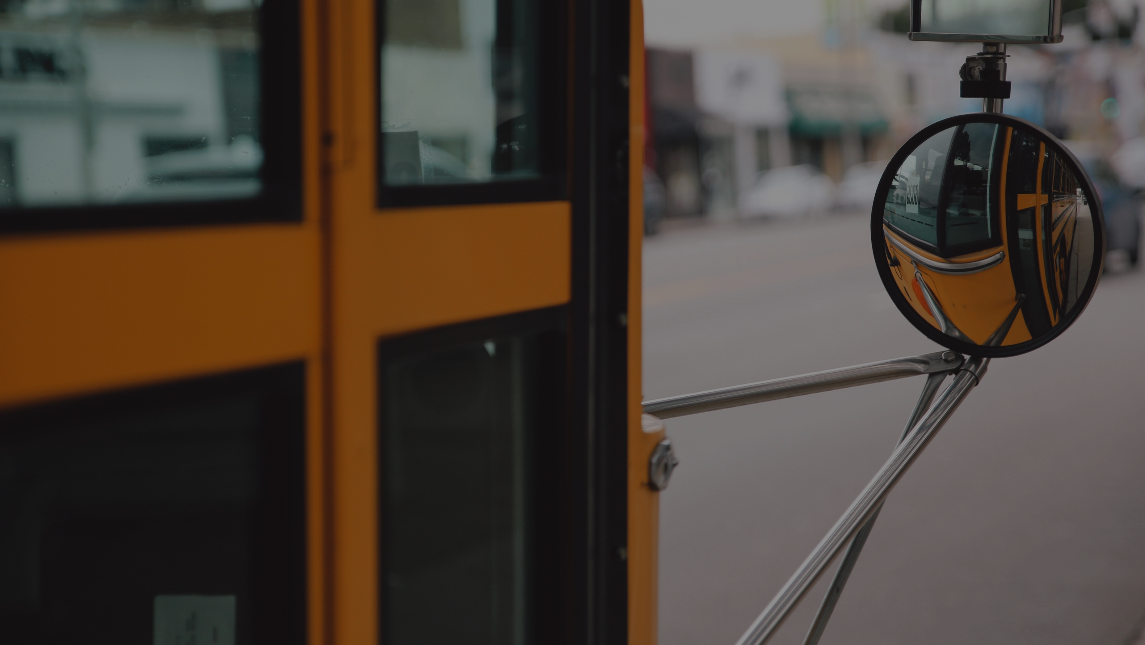
Problem Statement
The "Redbus Data Scraping and Filtering with Streamlit Application" aims to revolutionize the transportation industry by providing a comprehensive solution for collecting, analyzing, and visualizing bus travel data. By utilizing Selenium for web scraping, this project automates the extraction of detailed information from Redbus, including bus routes, schedules, prices, and seat availability. By streamlining data collection and providing powerful tools for data-driven decision-making, this project can significantly improve operational efficiency and strategic planning in the transportation industry.

Slide 4
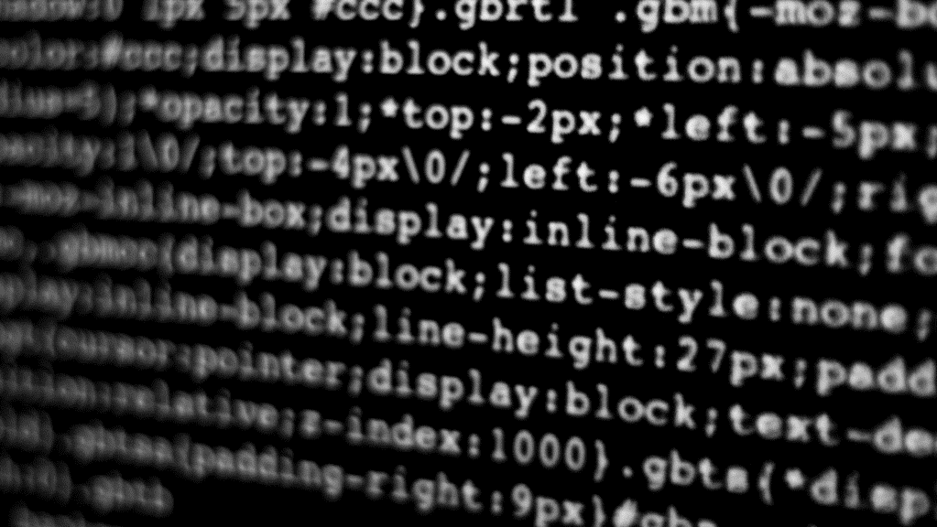
Under standing and process map
Using selenium library to extract required data from website and store it into SQL server.
Use streamlit to create a web based interface to do filtering in data’s
Start
Extract route URL and route name from website
From Every URL extract bus information
Store extracted information in SQL
Create DB and Table in SQL
Using stream lit to analyse and data filtering
End

Slide 5
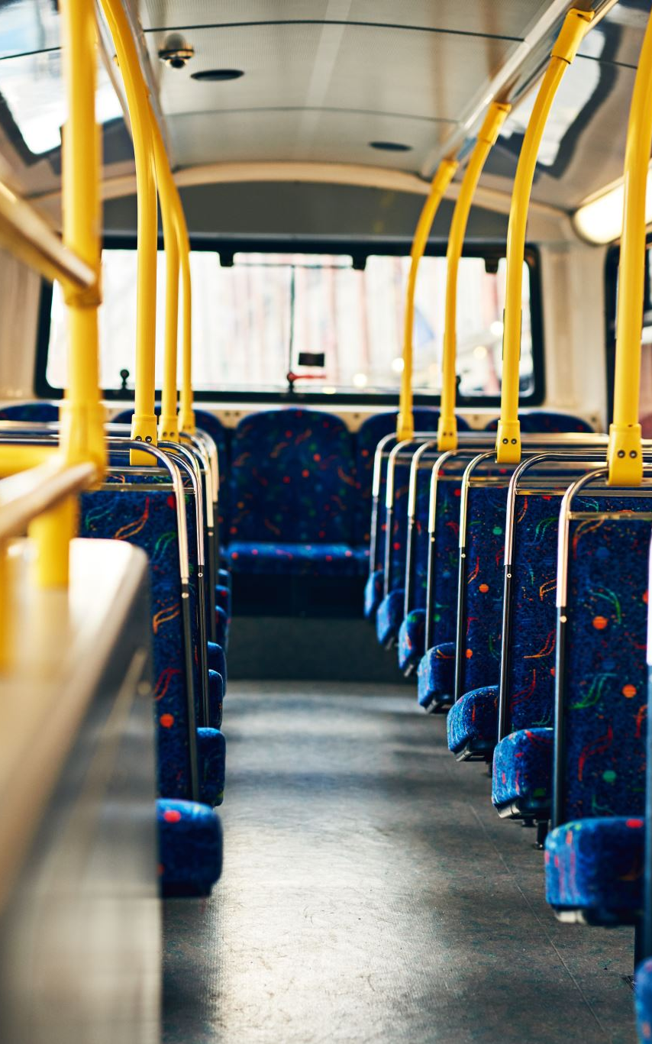
Data scraping using selenium
Using selenium library to extract the required information from website.
Based on the Class, XPATH object used to identify required information from website.
Once extracted store the files as CSV
Initially extract the route name and URL for the route.
Using URL extract the bus informations.

Slide 6
SQL Database
Create a Data Base as redbusproject
One database created create a two different tables for store extracted information
Table bus_route_information have the Bus route and URL
Table bus_information have the columns for
Bus name
Bus Type
Fare
Departure Time
Duration
Arrival Time
Star Rating
Seats Available

Slide 7
Streamlit design
Using Streamlit Library from python to create a filtering UI.
Once selected bus route, preferred departure time and price range, The filtered information will be displayed. With filtered condition.

Slide 8
Conclusion
Selenium Used to Scrap the data
SQL used to Store the Scrapped the data
Streamlit used to filtering the stored data in interactive UI.

Slide 9

THANK YOU

